Slide 1
Switching

Slide 2
Switched network
Develop suitable mechanism for communication between any two devices
One alternative is mesh topology
impractical because the number of links increases exponentially n(n-1)/2, where n is the number of devices
Better alternative
switching techniques leading to switched communication network

Slide 3
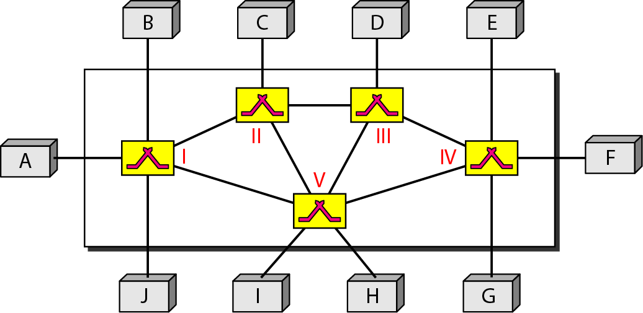

Slide 4
Switched network
a set of interconnected nodes,
among which information is transmitted from source to destination via different routes,
which is controlled by the switching mechanism.
The end devices that wish to communicate with each other are called stations.
The switching devices are called nodes.
Some nodes connect to other nodes and some are to connected to some stations.

Slide 5
Key features of a switched communication network
• Network Topology is not regular. • Uses FDM/TDM for node-to-node communication. • There exist multiple paths between a source-destination pair for better network reliability. • The switching nodes are not concerned with the contents of data. • Their purpose is to provide a switching facility that will move data from node to node until they reach the destination.

Slide 6
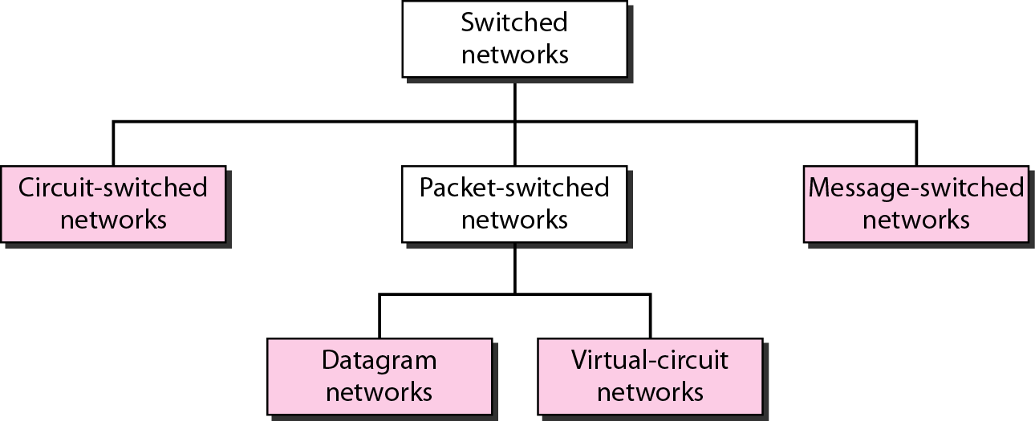
Switched Network Categories

Slide 7
Circuit Switching
Dedicated communication path between 2 stations.
Path is a connected through a sequence of links between network nodes.
On each physical link, a logical channel is dedicated to the connection.
Circuit switching is commonly used technique in telephony

Slide 8
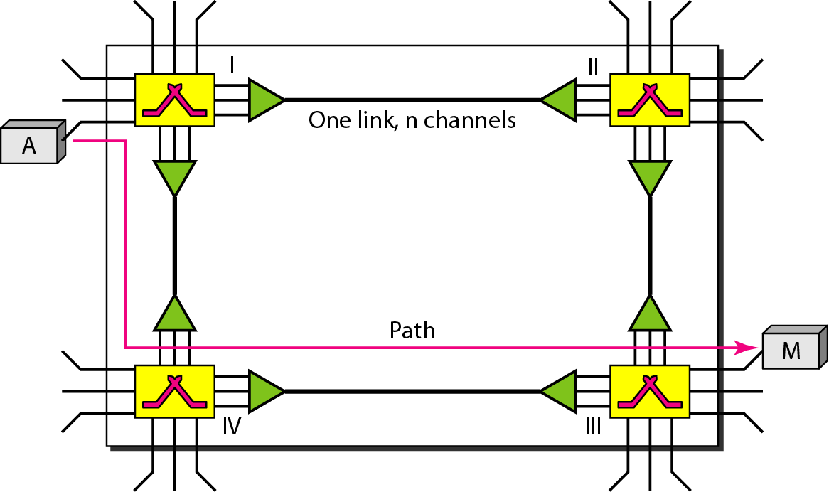

Slide 9
Example
Let us use a circuit-switched network to connect eight telephones in a small area.
Communication is through 4-kHz voice channels.
We assume that each link uses FDM to connect a maximum of two voice channels.
The bandwidth of each link is then 8 kHz.
Telephone 1 is connected to telephone 7; 2 to 5; 3 to 8; and 4 to 6.
Situation may change when new connections are made.
The switch controls the connections.

Slide 10
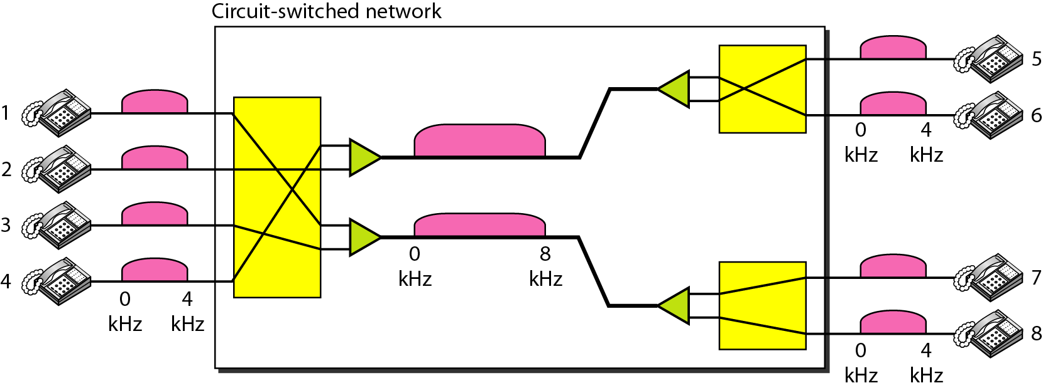

Slide 11
Example
Consider a circuit-switched network that connects computers in two remote offices of a private company.
The offices are connected using a T-1 line leased from a communication service provider.
There are two 4 × 8 (4 inputs and 8 outputs) switches in this network.
For each switch, four output ports are folded into the input ports to allow communication between computers in the same office.
Four other output ports allow communication between the two offices.

Slide 12
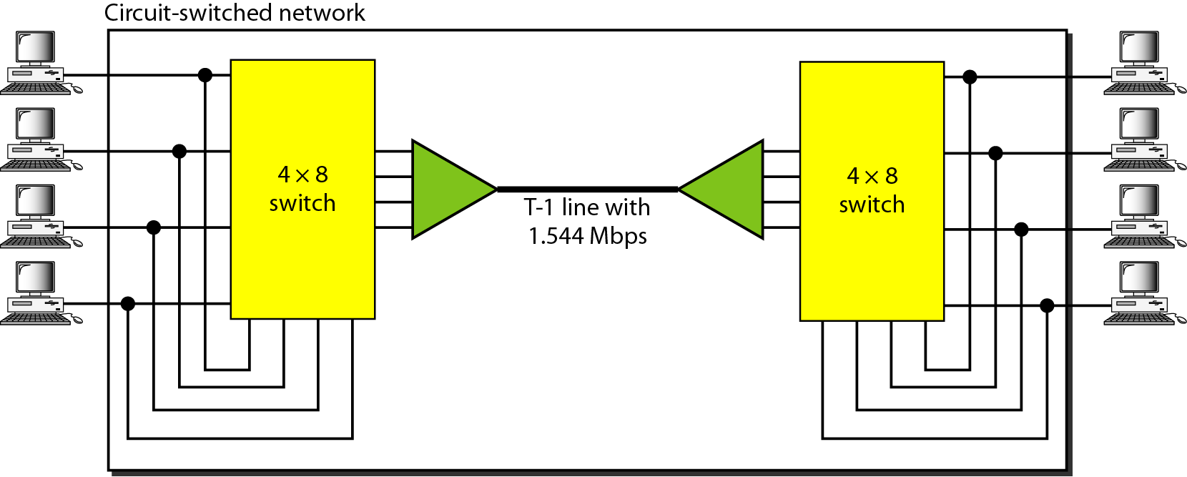

Slide 13
Circuit Switching: Steps involved
Circuit Establishment
Establish an end-to-end connection before any data transfer.
Some segments of the circuit may be a dedicated link, while some other segments may be shared.
Data transfer
Transfer data from source to destination.
Data may be analog or digital, depending on the nature of the network.
The connection is generally full-duplex.
Circuit disconnect
Terminate connection at the end of data transfer.
Signals must be propagated to deallocate the dedicated resources.

Slide 14
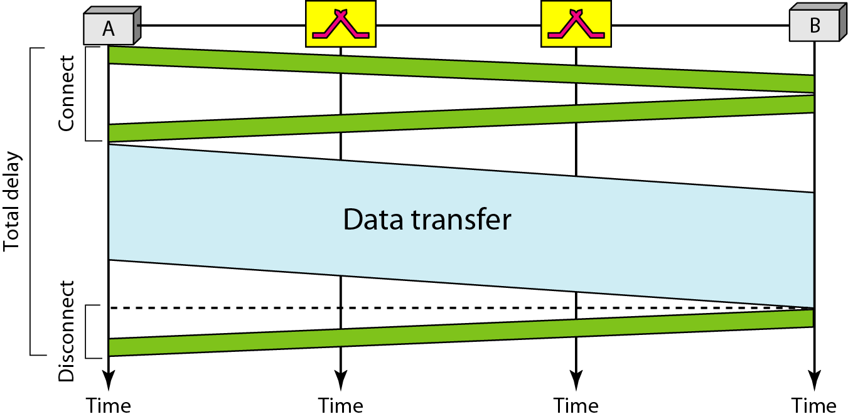
Connection Over a Public Circuit-Switching Network

Slide 15
Circuit Switching
Actual physical electrical path or circuit between the source and destination host must be established before the message is transmitted.
This connection, once established, remains exclusive and continuous for the complete duration of information exchange and the circuit becomes disconnected only when the source wants to do so.

Slide 16
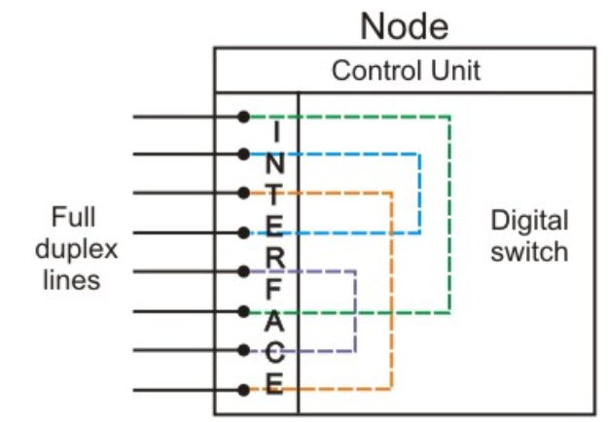
Structure of a switch
Major elements of a single-node network
Digital switch:
Provides a transparent (full-duplex) signal path between any pair of attached devices.
Network interface:
Represents the functions and hardware needed to connect digital devices to the network (like telephones).
Control unit:
Establishes, maintains, and tears down a connection.

Slide 17
Blocking and Non-blocking switches
A blocking network is one, which may be unable to connect two stations because all possible paths between them are already in use.
A non-blocking network permits all stations to be connected (in pairs) at once and grants all possible connection requests as long as the called party is free.
For only voice traffic, a blocking configuration may be acceptable, since most phone calls are of short duration.
For data applications, where a connection may remain active for hours, non-blocking configuration is desirable.

Slide 18
Circuit Switching: Categories
Space-division switches
Paths in the circuit are separated with each other spatially, i.e. different ongoing connections, at a same instant of time, uses different switching paths.
Originally developed for the analog environment, and carried over to the digital domain.
Some of the space switches are crossbar switches, Multi-stage switches (e.g. Omega Switches).
Basic building block of the crossbar switch is a metallic crosspoint or semiconductor gate that can be enabled/disabled by a control unit.
Time-division switches or a
combination of both

Slide 19
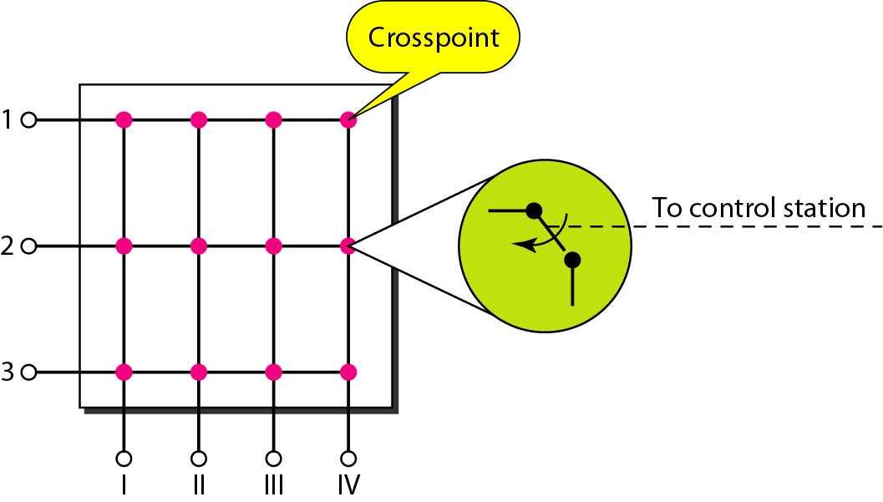
Crossbar Switch

Slide 20
Crossbar Switch
Connects n inputs to m outputs in a grid, using electronic micro switches (transistors) at each cross point.
Major limitation is the number of cross points required.
To connect n inputs to m outputs using a crossbar switch requires n x m cross points.
For example, to connect 1000 inputs to 1000 outputs requires a switch with 1,000,000 cross points.
A crossbar with this number of cross points is impractical.
Such a switch is also inefficient because statistics show that, in practice, fewer than 25 percent of the cross points are in use at any given time. The rest are idle.

Slide 21
Multistage Switch
Solves limitations of the crossbar switch.
Combines crossbar switches in several (normally three) stages.
In a single crossbar switch, only one row or column (one path) is active for any connection. So we need N x N cross points.
If we can allow multiple paths inside the switch, we can decrease the number of cross points.
Each cross point in the middle stage can be accessed by multiple cross points in the first or third stage.

Slide 22
Multistage Switch
To design a three-stage switch, we follow these steps:
We divide the N input lines into groups, each of n lines. For each group, we use one crossbar of size n x k, where k is the number of crossbars in the middle stage. In other words, the first stage has N/n crossbars of n x k crosspoints.
We use k crossbars, each of size (N/n) x (N/n) in the middle stage.
We use N/n crossbars, each of size k x n at the third stage.
total number of crosspoints as follows: (N/n)*(n x k)+k(N/n x N/n)+N/n(k x n) = 2kN+k(N/n)² < N² of crossbar

Slide 23
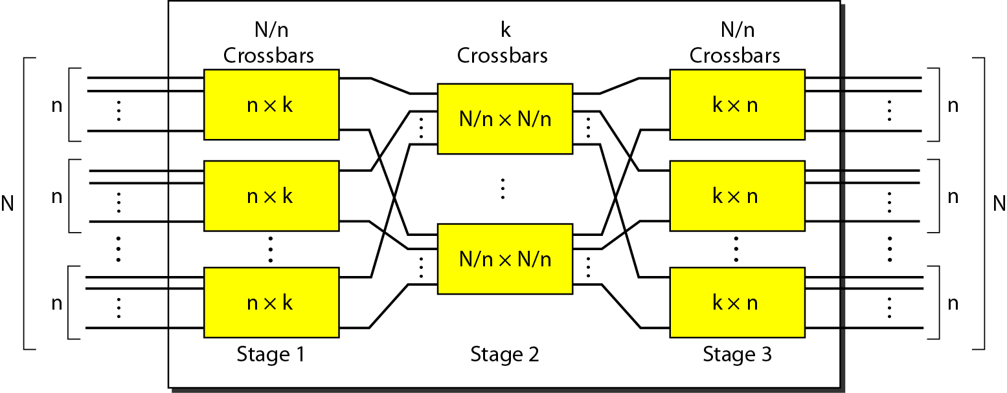

Slide 24
Design a three-stage, 200 × 200 switch (N = 200) with k = 4 and n = 20.
In the first stage we have N/n or 10 crossbars, each of size 20 × 4. In the second stage, we have 4 crossbars, each of size 10 × 10. In the third stage, we have 10 crossbars, each of size 4 × 20. The total number of crosspoints is 2kN + k(N/n)², or 2000 crosspoints. This is 5 percent of the number of crosspoints in a single-stage switch (200 × 200 = 40,000).

Slide 25
Clos criterion
According to the Clos criterion:
n = (N/2)^{1/2}
k > 2n – 1
Crosspoints ≥ 4N [(2N)^{1/2} – 1]

Slide 26
Redesign the previous three-stage, 200 × 200 switch, using the Clos criteria with a minimum number of crosspoints
We let n = (200/2)^{1/2}, or n = 10. We calculate k = 2n − 1 = 19. In the first stage, we have 200/10, or 20, crossbars, each with 10 × 19 crosspoints. In the second stage, we have 19 crossbars, each with 10 × 10 crosspoints. In the third stage, we have 20 crossbars each with 19 × 10 crosspoints. The total number of crosspoints is 20(10 × 19) + 19(10 × 10) + 20(19 ×10) = 9500.

